Slide 1

WADcher
Web Accessibility Directive Decision Support Environment
Dr Carlos A Velasco, Dr Yehya Mohamad - Fraunhofer Institute for Applied Information Technology FIT
Dr John J. O’Flaherty - MAC
https://wadcher.eu/
WAI-Tools Open Meeting 20 May 2019, Brussels, Belgium

Slide 2
Project partners
Horizon 2020 IA (Grant Agreement No 780206)
  Duration: Jan 2018 – Dec 2020
Project partners (6 countries)
  Fraunhofer-Gesellschaft zur Förderung der angewandten Forschung e.V., Fraunhofer FIT (Germany)
  The National Microelectronics Applications Centre LTD (MAC, Ireland)
  Consiglio Nazionale delle Ricerche (CNR, Italy)
  Hilfsgemeinschaft der Blinden und Sehschwachen Österreichs (HG, Austria)
  Agenzia per l’Italia Digitale (AgID, Italy)
  Dextera Consulting Ltd (Cyprus)
  Hellenic Ministry for Health (ΜοΗ, Greece)
  Ethniko Kentro Erevnas kai Technologikis Anaptyxis (CERTH, Greece)

Slide 3

Aim
Research, develop and demonstrate an innovative and sustainable Decision Support Environment + WAD Observatory for large scale web accessibility assessment services

Slide 4
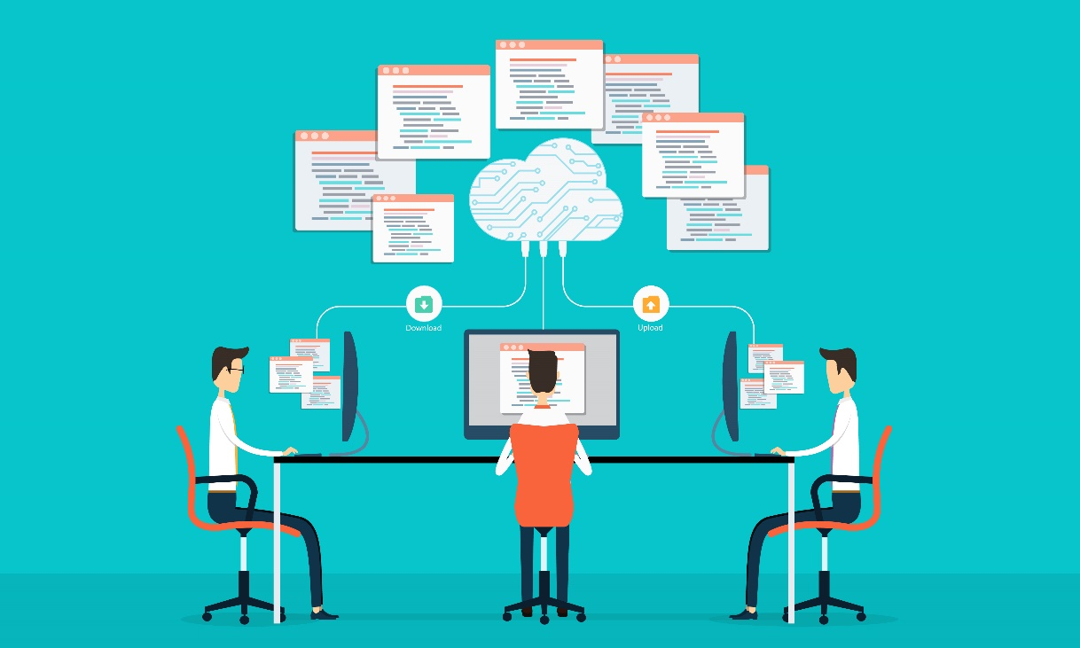
Which problem are we addressing?
Support member states to monitor WAD compliance in a large scale manner
Improve the lack of knowledge/skills for building accessible web solutions with monitoring and evaluation tools
Provide a harmonized set of procedures based on semantic standards (EARL) to avoid different interpretations of accessibility evaluations
Reduce accessibility implementation costs
Support the integration of different accessibility evaluation tools to improve the depth and reliability of accessibility testing results

Slide 5

Objectives
Build a large-scale WAD assessment infrastructure
Develop and demonstrate advanced decision support tools for assisting developers and designers to create accessible assets
Implement a web accessibility observatory platform for hybrid combination of automatic/expert reviews
Validate WADcher results in real pilot settings
Develop methods and to measure the evidence, accuracy and quality of testing results
Liaise with standardisation bodies
Sustainable exploitation

Slide 6
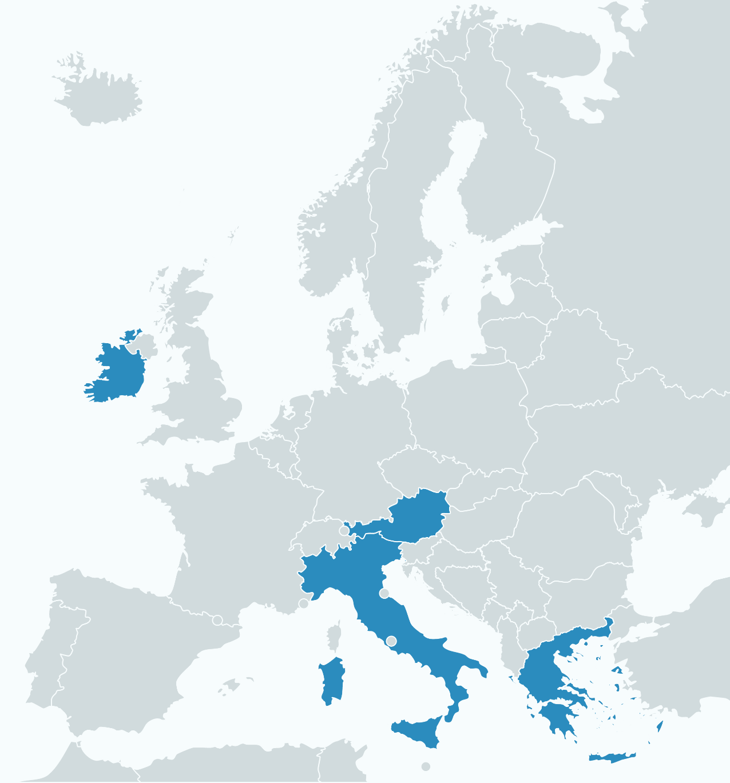
Pilot sites
Generic objectives:
  WADcher tools evaluation
  Periodic WAD simplified monitoring and in-depth testing
  WAD Evaluation Reports
  Generating WAD Accessibility Statements
  Periodic National WAD Reports
Notes:
Web Applications Providers and Commissioners
Public organisations responsible for commissioning the content & multimedia of Web sites, also private enterprises
Content & Tools Developers + Designers
To support them in development & testing of accessible web applications
Web Accessibility Experts
To interpret their results, provide guidance, certification
WAD Monitoring and Policy Bodies
EU, National WAD-related bodies, NGOs dealing with WAD monitoring + implementation

Slide 7
WADcher Exploitation Goals
Web Accessibility by default
  All citizens using all services that are fully inclusive and accessible to everyone, everywhere, every time and on every device on which they wish to use them
  Sustainable deployment of the WADcher WAD compliance and decision support services by the project partners and others, to help ensure such inclusion and accessibility across Europe
  Wide-spread adoption and sustainable evolution of the WADcher services/tools for use by users, developers, commissioners and accessibility experts

Slide 8

Technical overview

Slide 9










Users
LDAP
server
Web Accessibility
Evaluation Tools
Security Layer
Authentication/
Authorization
ACL/Roles
imergo®
Application Layer
WADcher Observatory
WADcher DSE
MAUVE
WaaT
Message Broker
Service
Orchestrator
WADcher
APIs
Other
Tools
Service Layer
Knowledge Layer
Data
Analytics
Semantic
Interoperability
Guidelines/
Regulations
Persistence Layer

Slide 10
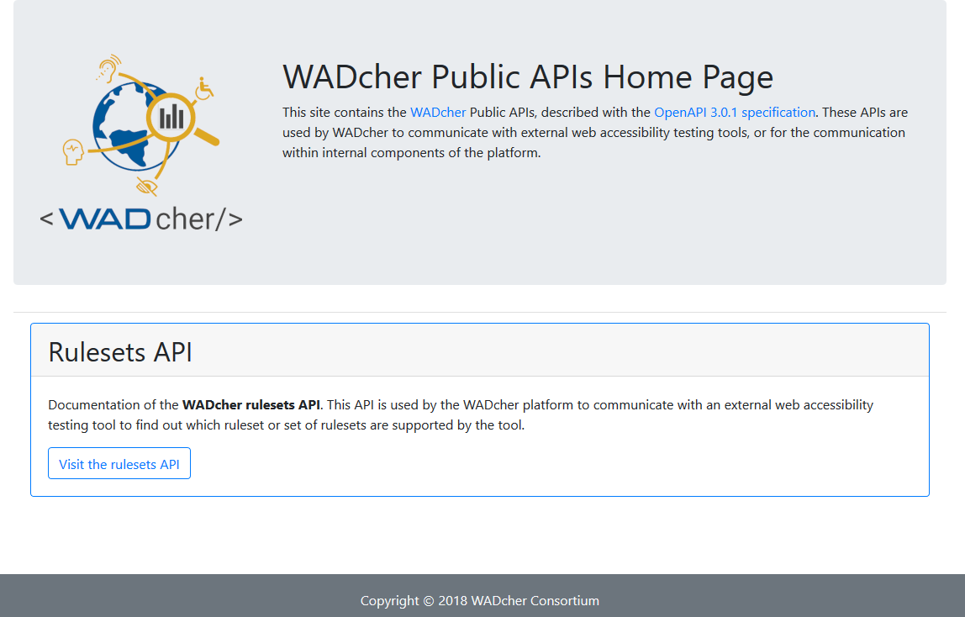
WADcher APIs
Open set of APIs + models + interfaces
Enable all Accessibility Evaluation tools
  to use WADcher WAD-compliance platform
Notes:
https://wadcher-apis.wadcher.fit.fraunhofer.de/

Slide 11
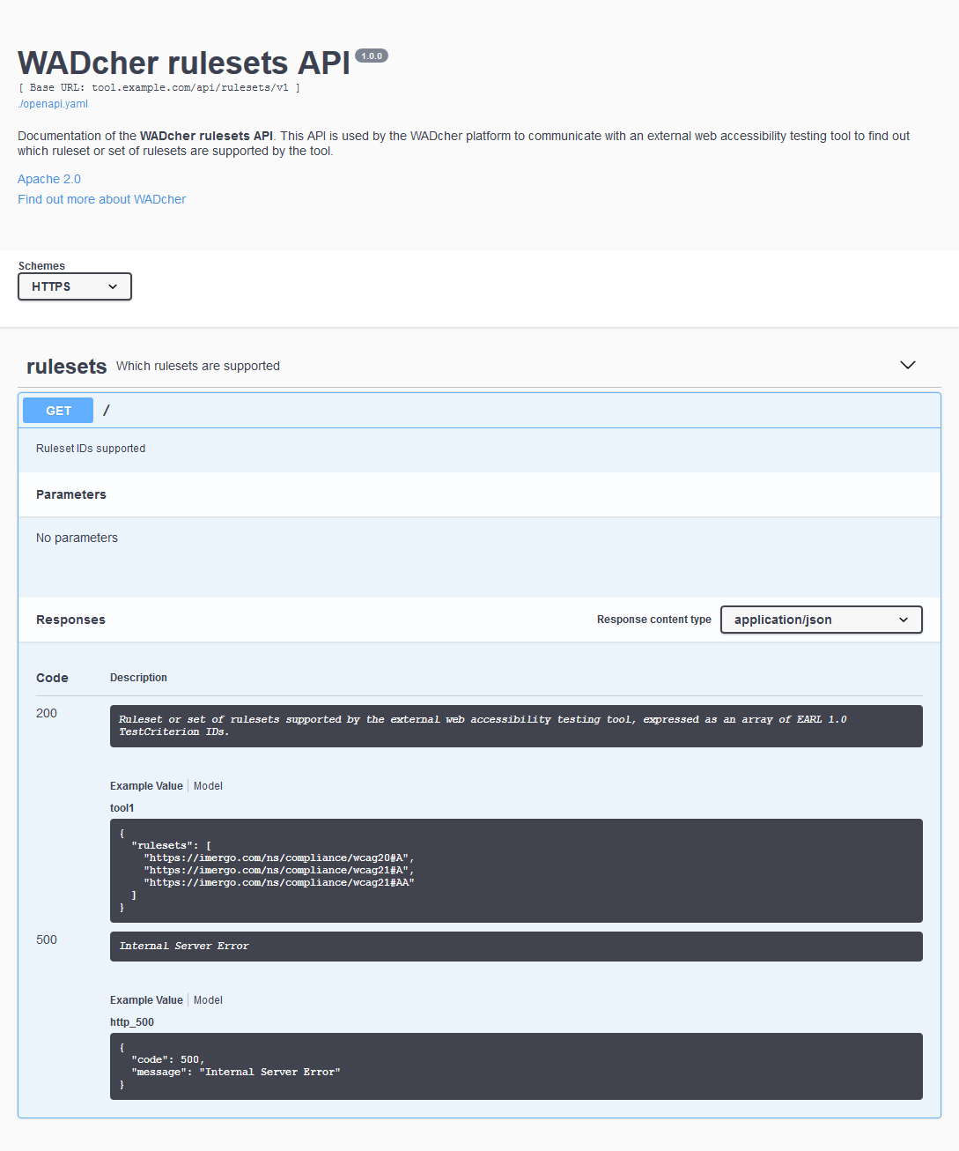
Rulesets API
Open API: allows the WADcher platform to communicate with external web accessibility testing tools
  to determine which Accessibility Standard ruleset or set of rulesets are supported by the tool

Slide 12
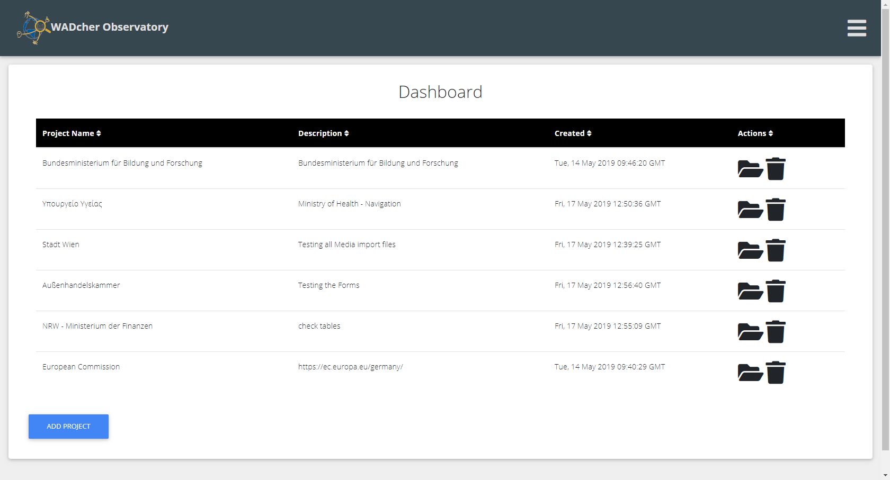
WADcher Observatory :: Dashboard
Notes:
Project overview

Slide 13
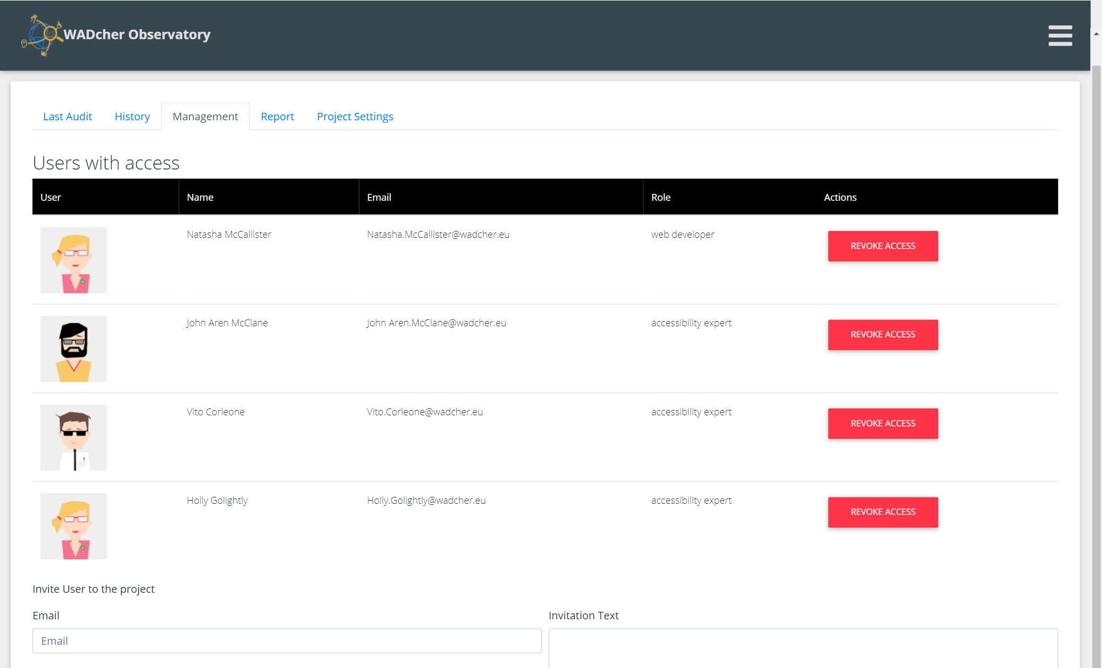
WADcher Observatory :: Management
Notes:
Project overview

Slide 14
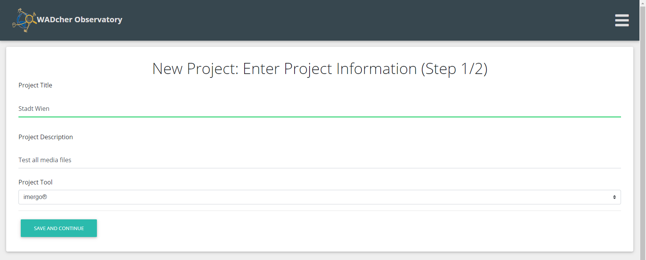
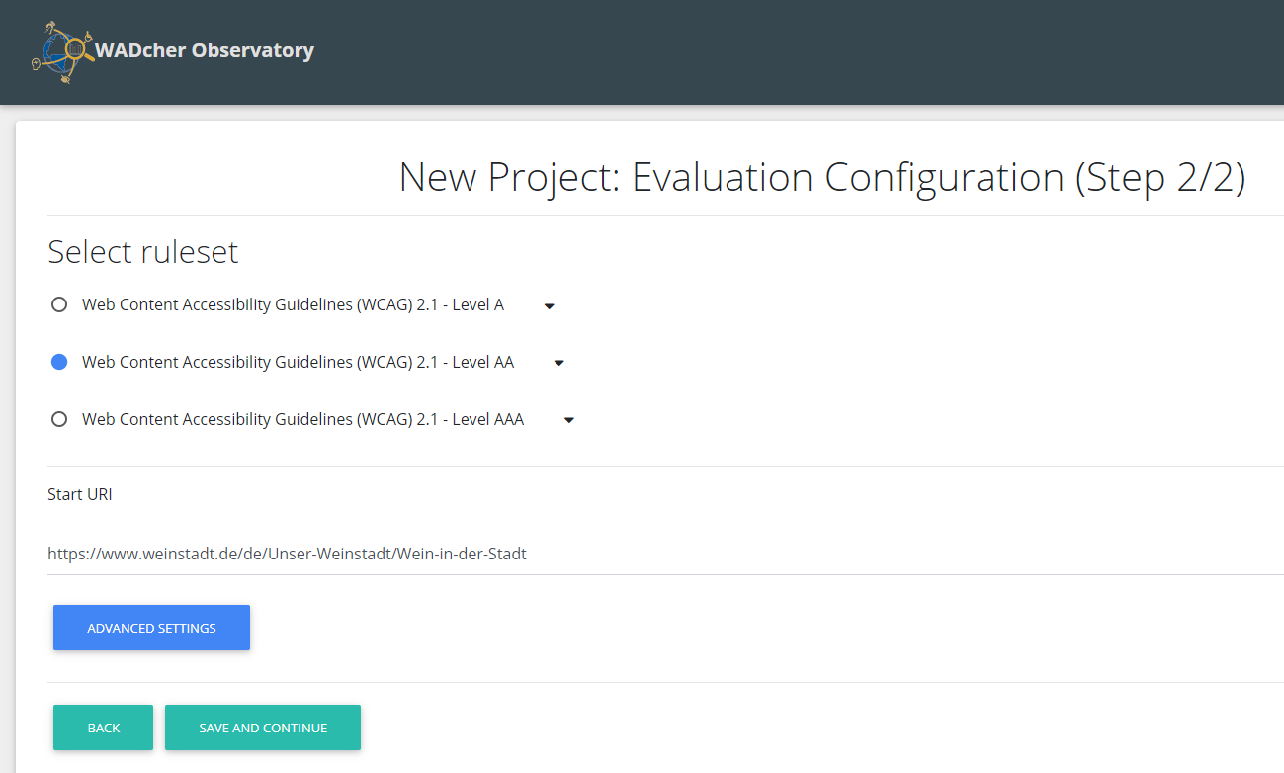
WADcher Observatory :: New project
Notes:
Project overview

Slide 15
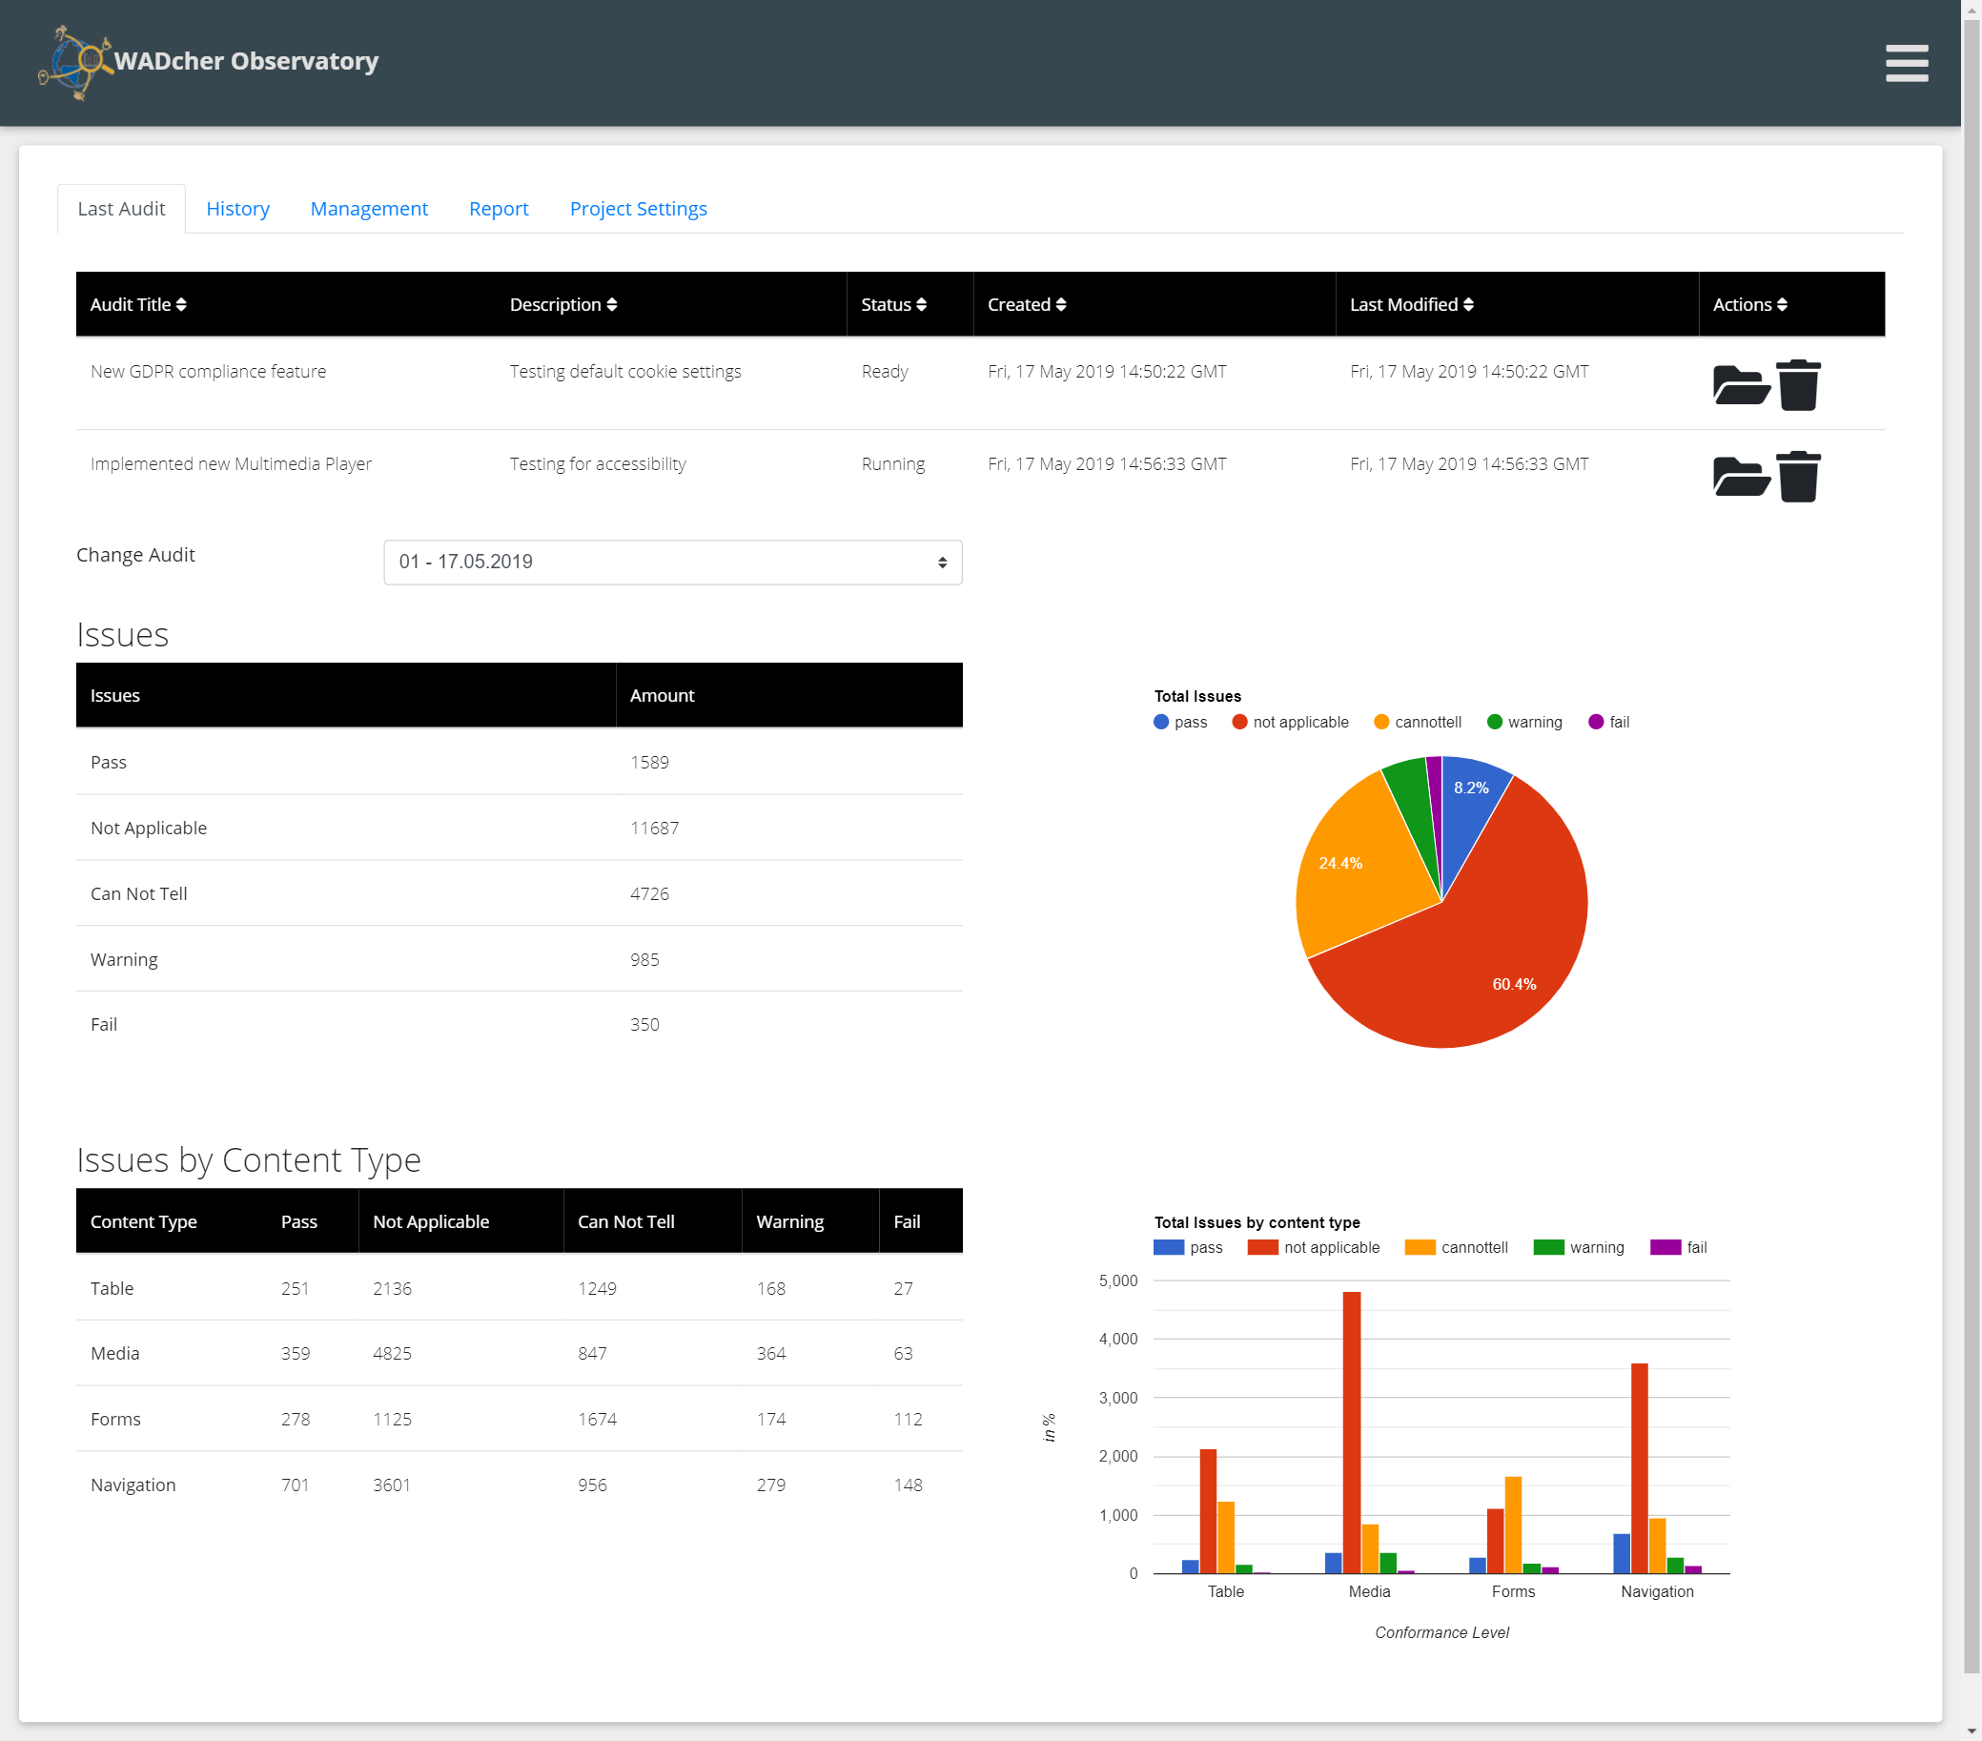
Audit statistics

Slide 16

Q&A
Project website:
https://wadcher.eu/
LinkedIn group: WAD - Web Accessibility Directive Support Environment – WADcher
https://linkedin.com/groups/8741067/
images © WADcher project, Shutterstock, Fotolia, Pexels.com

